Slide 2

THIS JUST IN
SHOP NEW ARRIVALS >>

Slide 3
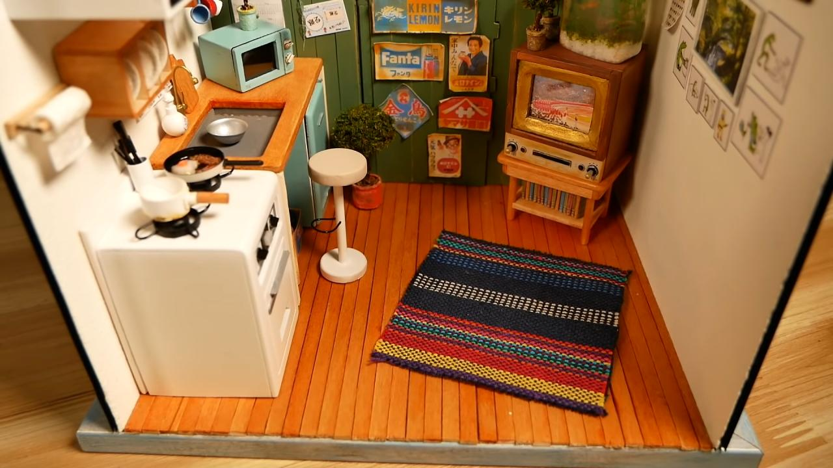
NEW ARRIVALS
QUAINT INTERIORS
SHOP NOW >>

Slide 4

NEW ARRIVALS
Rustic Chic
SHOP NOW >>

Slide 5
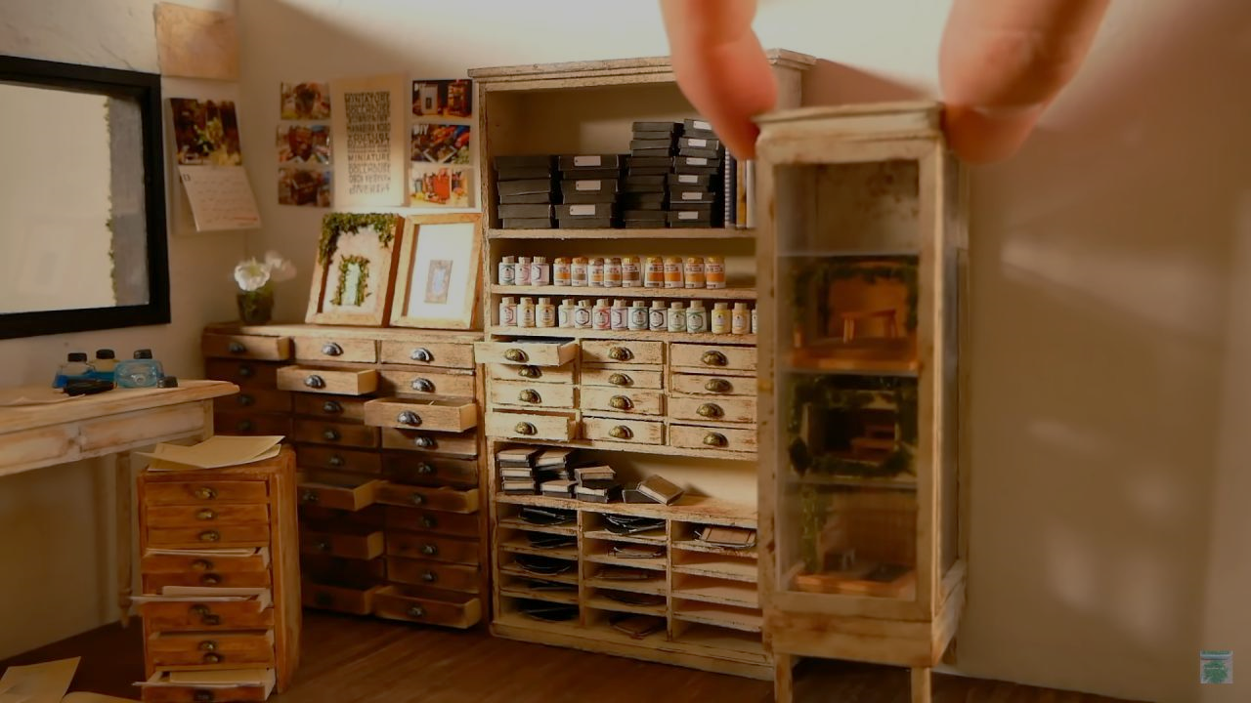
NEW ARRIVALS
AGREEABLE
ACCOUTREMENTS
SHOP NOW >>

Slide 6
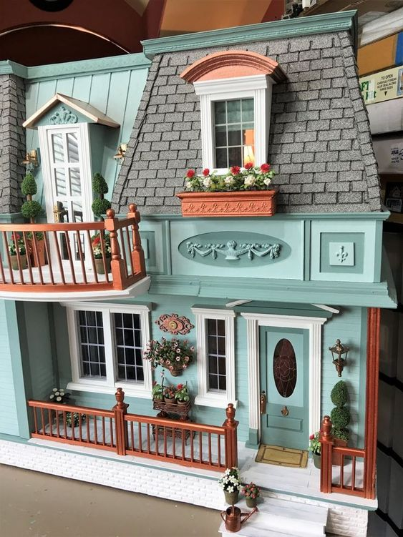
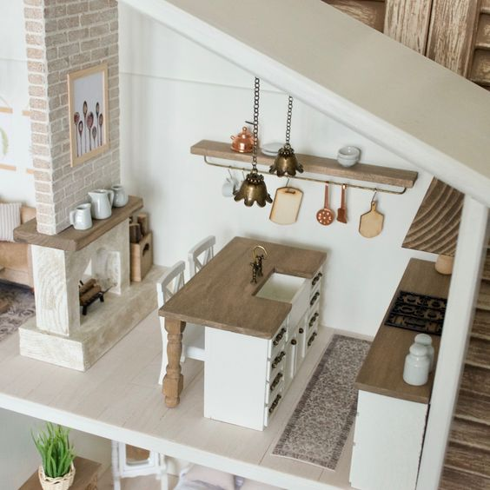
SHOP DREAMHOUSES >>
SHOP FURNITURE >>

Slide 7


SEASONAL FATHER’S DAY SALE
SHOP TIFFANYDOLLS >>
UP TO 30% OFF DREAMHOUSES >>

Slide 8
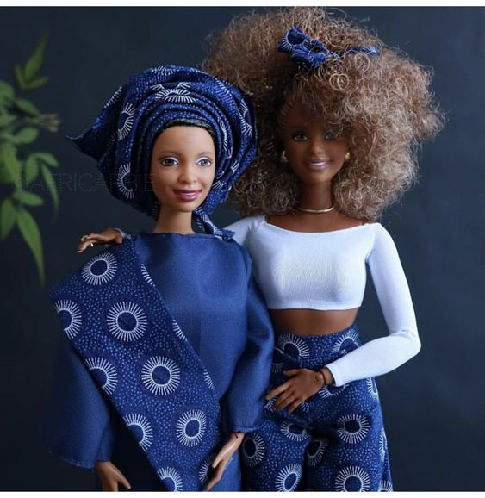
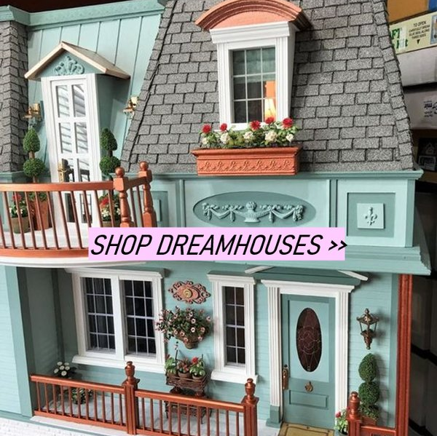
SHOP TIFFANYDOLLS >>

